Slide 1
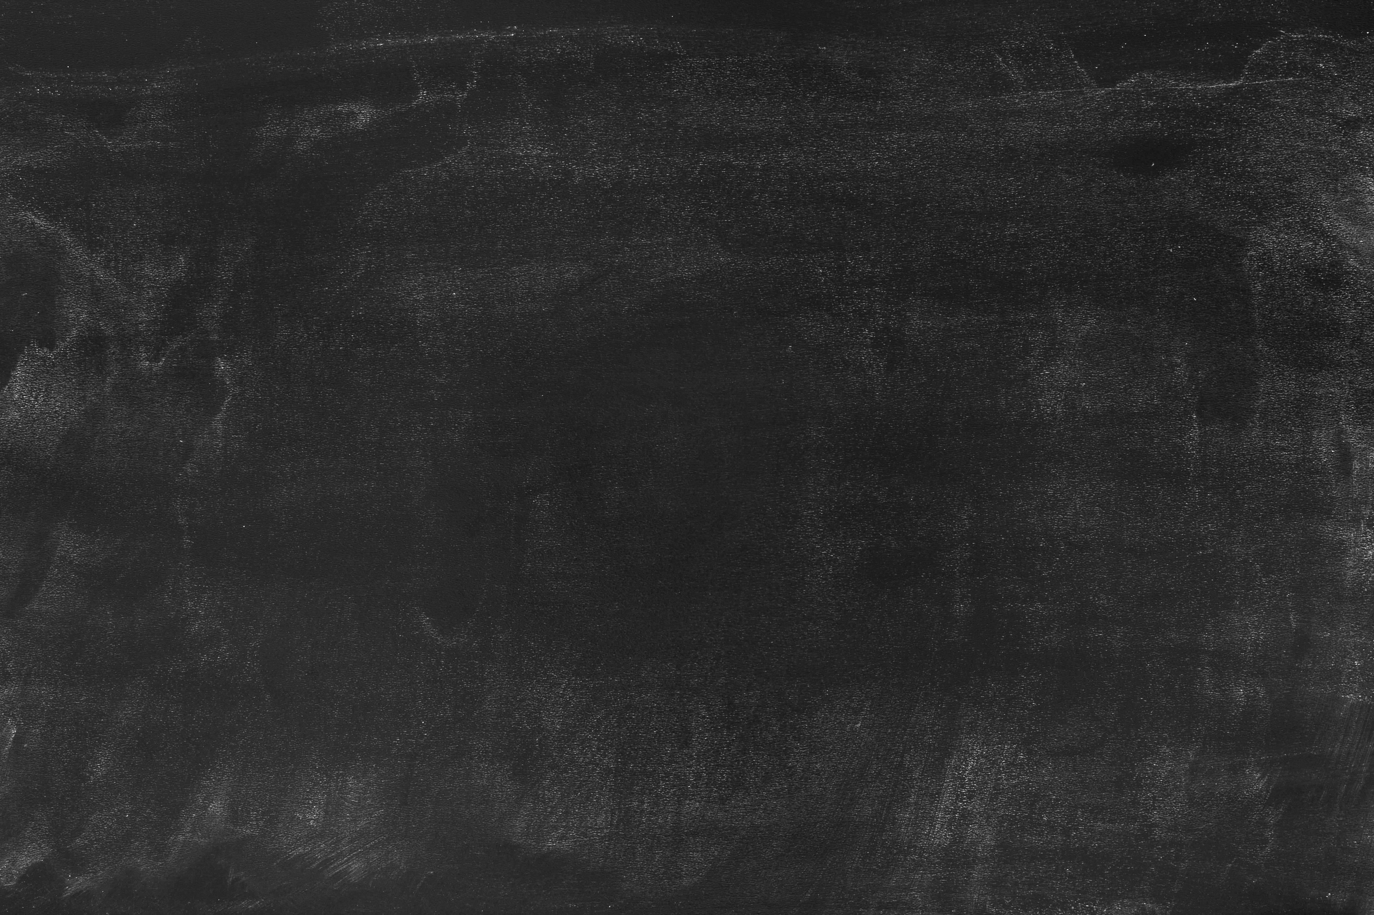
Review of the Basics

Slide 2
Spark DStreams use abstractions called RDDs
Incoming data is divided into chunks that can be operated on in parallel or in series
Remember our Coffee house analogy
Operations on one stream or set of RDDs results in a new stream or set of RDDs
The result is a growing chain of dependencies
In some cases, we can use Spark SQL to make DStreams behave like SQL dataframes.

Slide 3
Can use a variety of functions on DStreams
Some examples of what we’ve covered include:
Lambda functions
Functional programming is extremely useful for operations on streams
Transformations
Either built in (map, flatmap, union, groupBy, etc.), or custom-made using the Transform() operation.
Window functions
window(), countByWindow(), reduceByKeyAndWindow(), countByValueAndWindow() work on intervals of time in your stream

Slide 4
DStreams have a variety of input & output options
Can take in DStream from a source
ssc.textFileStream(dataDirectory)
ssc.socketTextStream(host, port)
Can create a DStream from scratch
ssc.queueStream(queueOfRDDs)
ssc.queueStream(parallelize([arrayOfRDDInputs]))
Can output to a file or console
ssc.saveAsTextFiles(prefix, [suffix])
pprint()
ssc.foreachRDD(customFunction)

Slide 5
To the Final Exercise!

